Slide 1
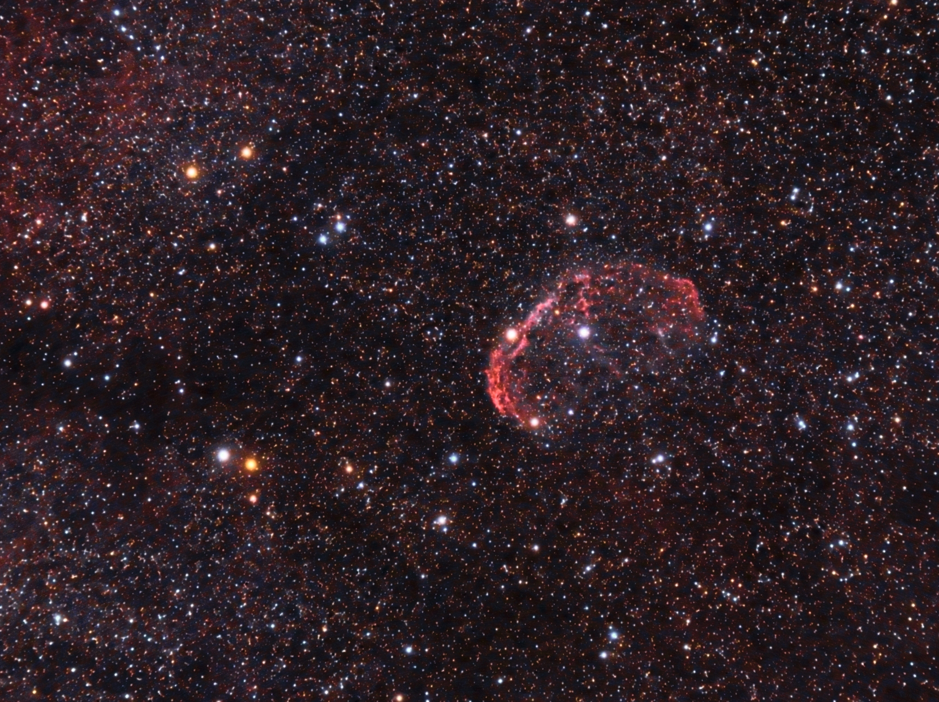
RS Cygni

Slide 2
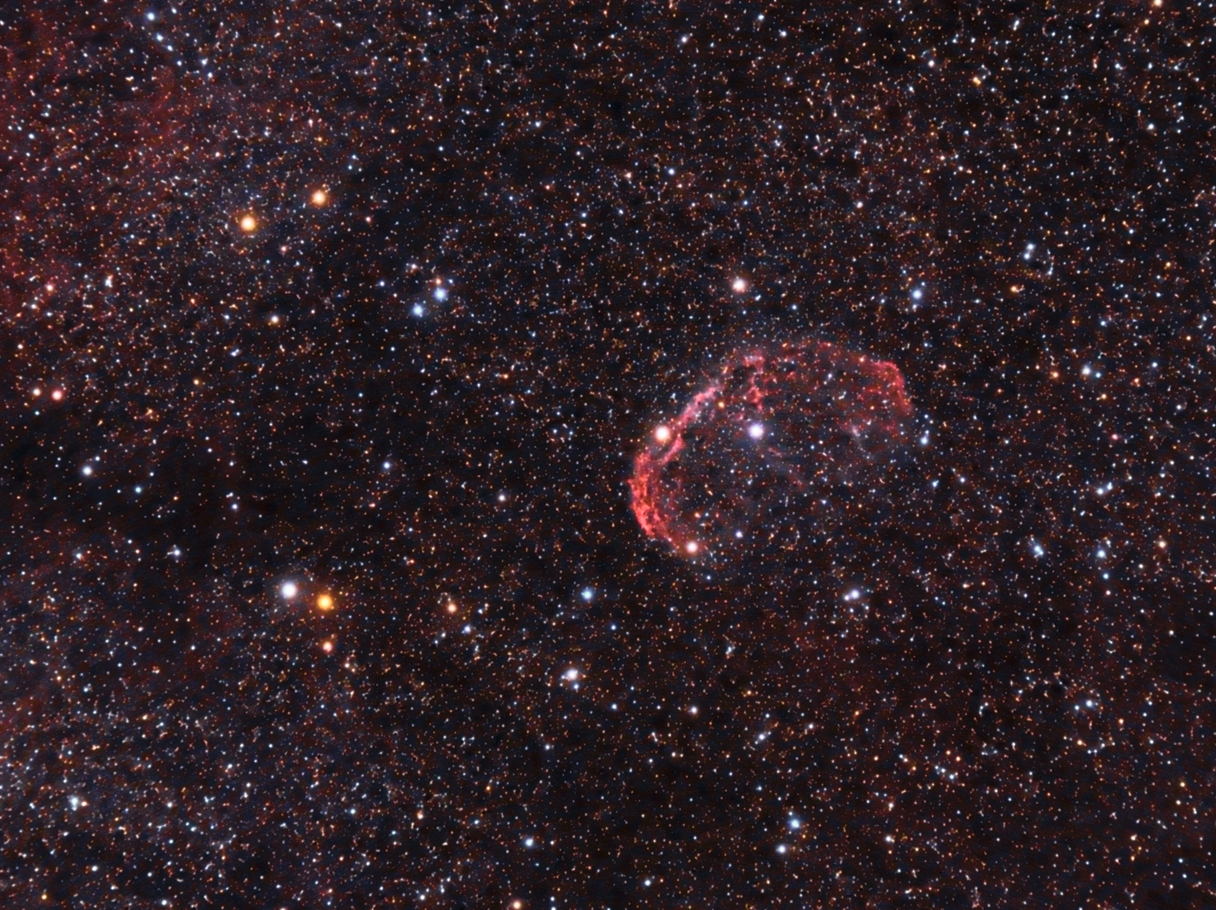
RS Cygni is a red variable carbon-star giant in the constellation Cygnus, lying close to the Crescent nebula.
Crescent Nebula
RS Cygni

Slide 3
It has semi-regular variability, with a period between 417 and 434 days. It is actually a double star.
RS Cygni
Crescent Nebula
RS Cygni is visible with binoculars or small telescopes.

Slide 4
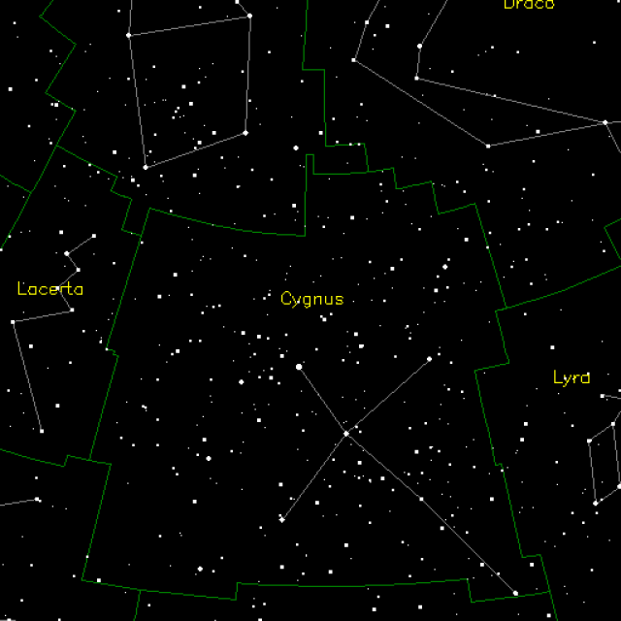
RS Cygni

Slide 5

Size: Unknown
B-V Color Index: +2.98, red
Luminosity: 157 Suns visual
RS Cygni

Slide 6
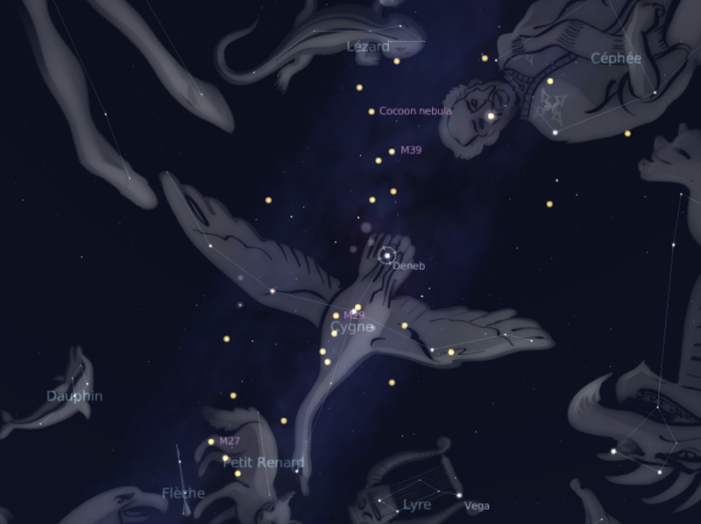
Cygnus Constellation:
The Swan
RS Cygni

Slide 7
Distance: 1,500 light years
Temperature: Unknown
Mass: Unknown
Magnitude Range: +6.50 to +9.50
RS Cygni

Slide 8
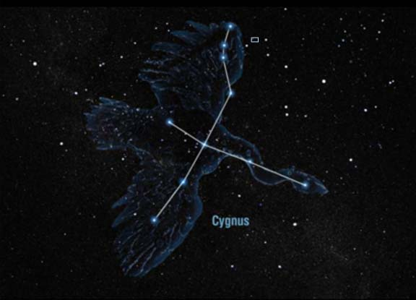
RS Cygni

Slide 9

Carbon Star Basics
As sun-like stars age, their core compresses and heats up and basically cooks the helium nuclei into carbon. The convective currents in the star’s atmosphere move the carbon from the core to the outer layers where they form a fine soot. The soot scatters away blue and green light, so only the red and orange wavelengths penetrate the carbon dust to reach our eyes.

Slide 10
Carbon Star Basics
• Sunsets are red for similar reasons to carbon stars. At the horizon, sunlight travels through more atmosphere, scattering away the blues and greens, leaving the red for our eyes.
• All carbon stars are variable and vary in brightness over the course of months or even more than a year.

Slide 11


Slide 12


Carbon Star Basics

Slide 13

Carbon Star Basics
Carbon stars vary in color. What color do you see in the telescope?

